Slide 1

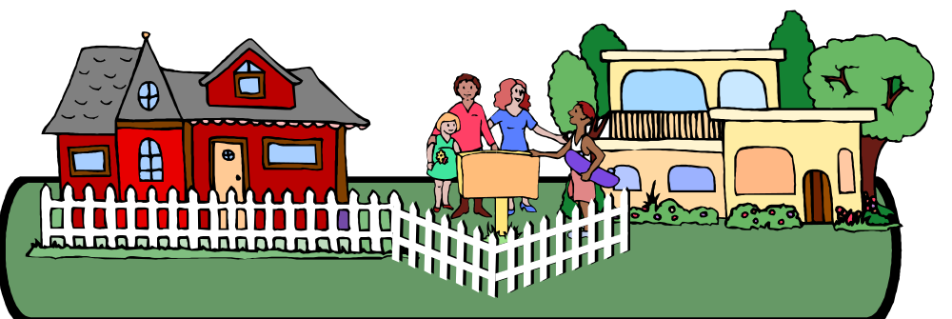
Neighbors and Friends
Helping Address Intellectual Freedom Challenges in Your Community
Notes:
I’m going to be talking pretty fast
I don’t have handouts
The good news is that you don’t really have to remember all of this
My PowerPoint presentation, along with my notes, is up on the FOLIO web page

Slide 2
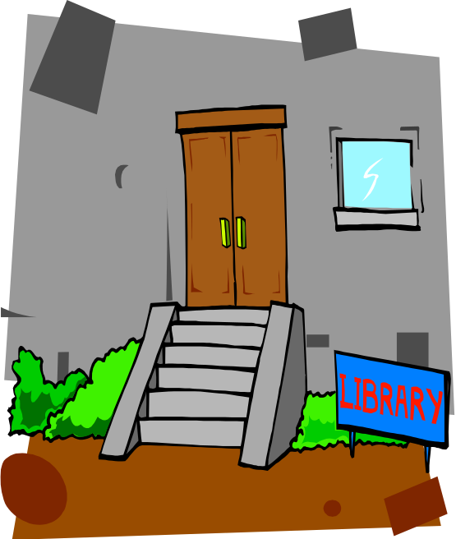

Who am I and why am I here talking about this?
Notes:
Who am I and why am I here talking about this?
Obviously I’m a library supporter, like all of you
FOLIO Board member
Like several other Board members, career librarian
Most of my career spent in public libraries
Worked on the collections side, which gave me experience with challenges
I know what it’s like to have someone come up and tell you what they think is wrong with the library’s collection
It’s one thing to have happen when it’s your job
You have had training on how to deal
You kind of expect it
But when it’s not your job, it can catch you off guard
I want to give some ideas of how to be prepared and respond

Slide 3


Intellectual freedom is the freedom to hold, receive, and disseminate ideas without restriction
Notes:
Intellectual freedom is the freedom to hold, receive, and disseminate ideas without restriction
That’s it

Slide 4

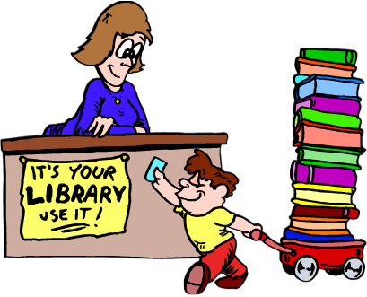
In libraries, intellectual freedom is the right of library users to read, seek information, and speak freely as guaranteed by the First Amendment
Notes:
ALA defines as the right of library users to read, seek information, and speak freely as guaranteed by the First Amendment
This little guy and his wagon have made an appearance in every presentation I’ve given for probably 20 years
I’d miss him if he weren’t here

Slide 5


Intellectual freedom is often associated with attempts to prevent libraries from providing access to materials or ideas, or to limit access to materials or ideas
Notes:
In a library context, ALA defines as the right of library users to read, seek information, and speak freely as guaranteed by the First Amendment
Often associated with censorship or book banning
In the library world, we associate it with attempts to prevent libraries from providing access to certain materials
We hope these guys are putting books into the library, not taking them out

Slide 6
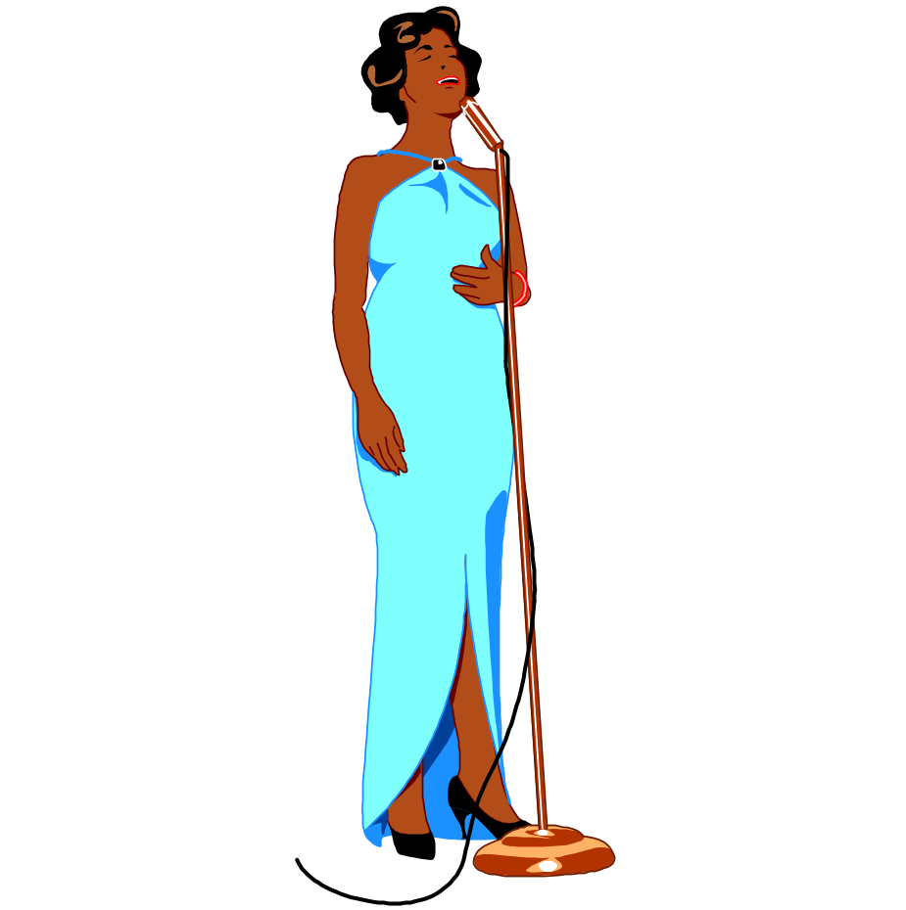
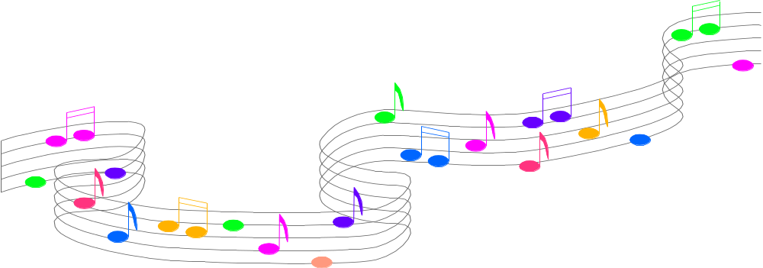

At its core, intellectual freedom is about
Notes:
At its core, intellectual freedom is about respect
And thank you, Miss Aretha

Slide 7







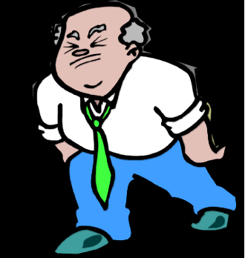

As library Friends, we respect each person’s right to access and absorb whatever ideas they choose in the manner they choose
Notes:
We respect each person’s right to absorb whatever ideas they choose in a reasonable manner
Not sure stone tablets are the best resource, but hey

Slide 8


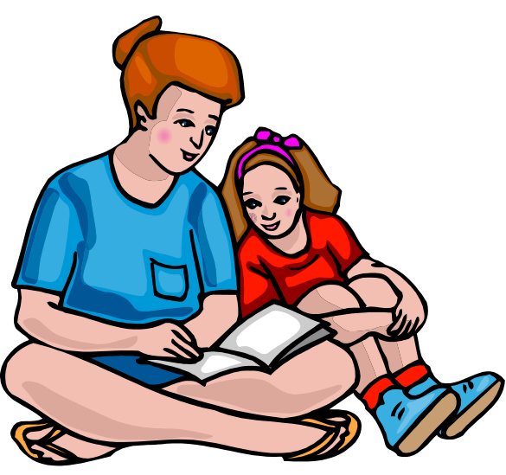
As library Friends, we don’t judge another person’s choices as to what ideas they absorb, or what ideas they teach their children
Notes:
We don’t judge another person’s choices as to what ideas they absorb, or what ideas they teach their children
One key to remember is their own children

Slide 9

As library Friends, we respect the fact that every viewpoint is equally available within libraries, even if we disagree with it
Especially if we disagree with it
Notes:
We respect the fact that every viewpoint is equally available within libraries
Even if we disagree
Especially if we disagree
We hold ourselves to the same standards as everybody else

Slide 10



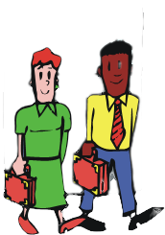
These days, people seem to have an opinion about everything
Notes:
These days, people seem to have an opinion about everything
Including everything about libraries
And they want to tell somebody about it
If they approach the library, great
Libraries are prepared to deal with them

Slide 11
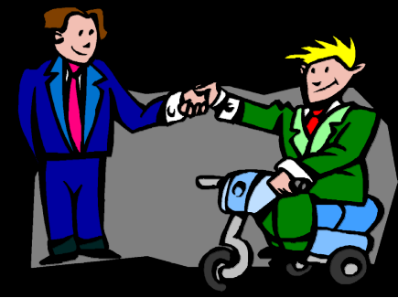

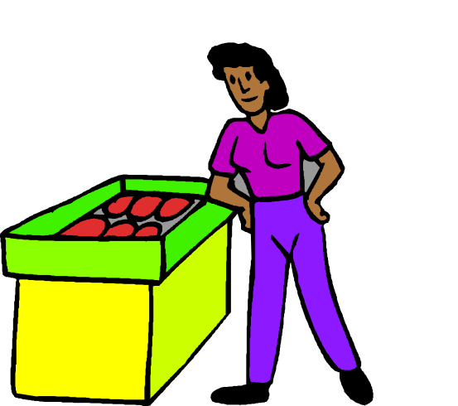
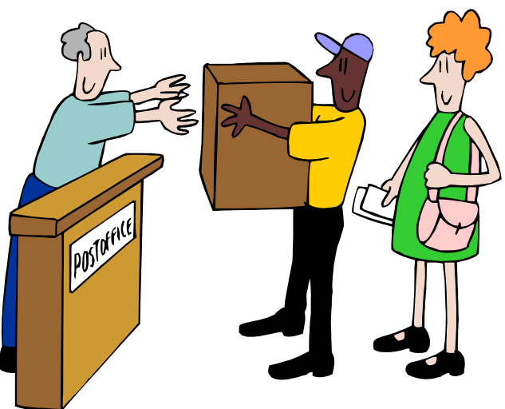

They recognize you
They know you are a library supporter
Notes:
Some people may not choose to approach the library, but to approach a Friends member
Why might someone approach you?
They recognize you
They know you are a library supporter
You’re someone they might see at the grocery store, or the post office, or even the library

Slide 12
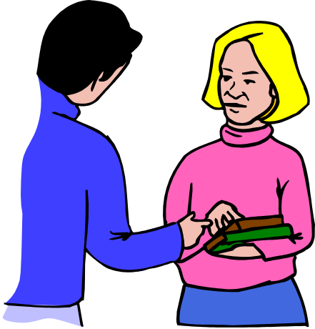
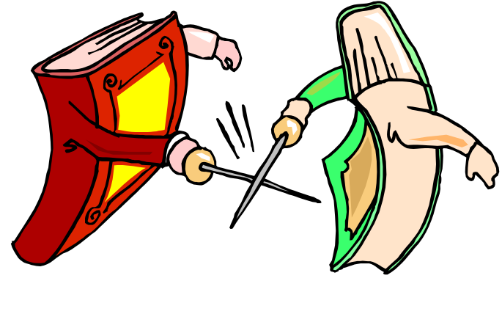
They may see you as more accessible than library staff
They might see you as more receptive to hearing their side
Notes:
They may see you as more accessible than library staff
They don’t have to go to the library to see you
Or they might see you as more receptive to hearing their side

Slide 13
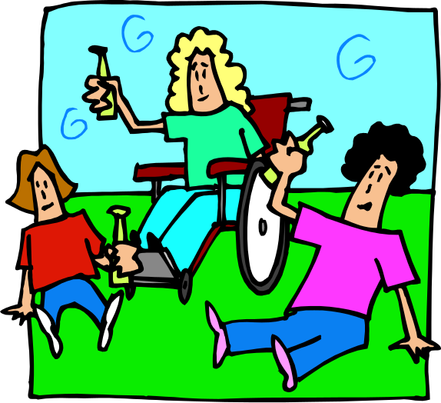
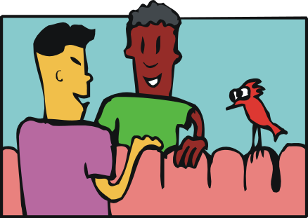
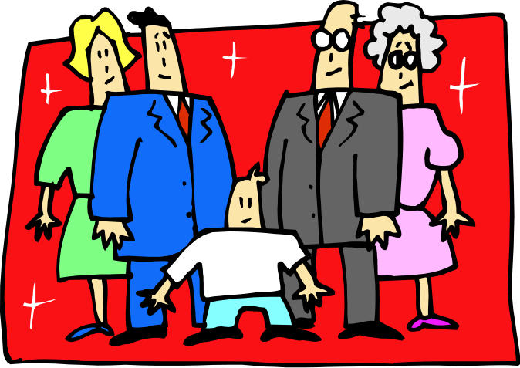
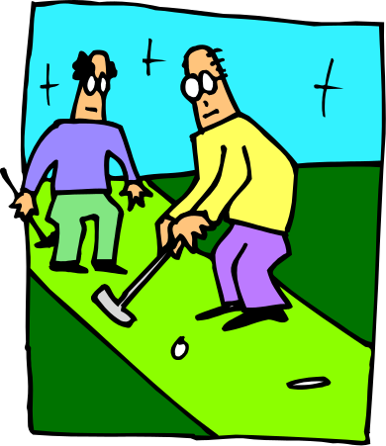
People you know casually
People involved in the same activities as you
  Clubs
  Church
  Family members
Notes:
Who might approach you?
People you know casually
People involved in the same activities as you
Church
Clubs
Family members

Slide 14



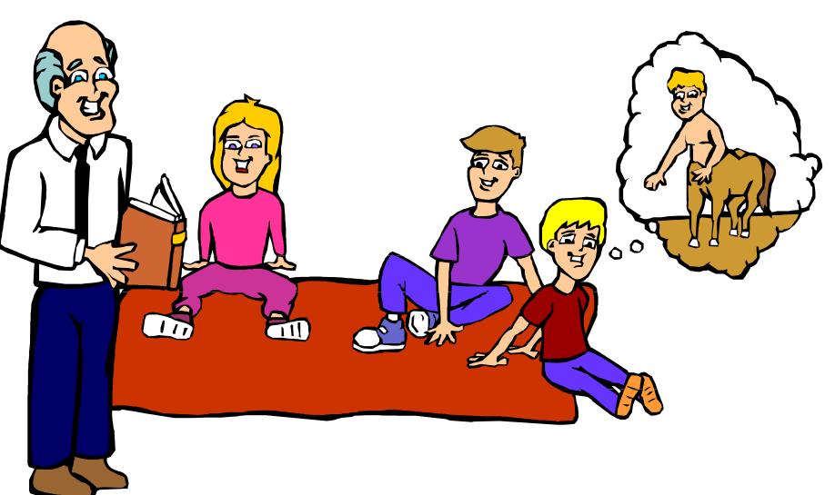
Things someone might be concerned about in the library
Something in the library collection
Programming that the library is offering
Displays in the library
Notes:
What might they be concerned about?
Something in the library collection
This is a frequent target
The library may offer materials that present a viewpoint that they object to
Programming that the library is offering
Maybe who’s leading a storytime
The topic of a program
Displays in the library
Some people see a display as endorsing a particular view

Slide 15
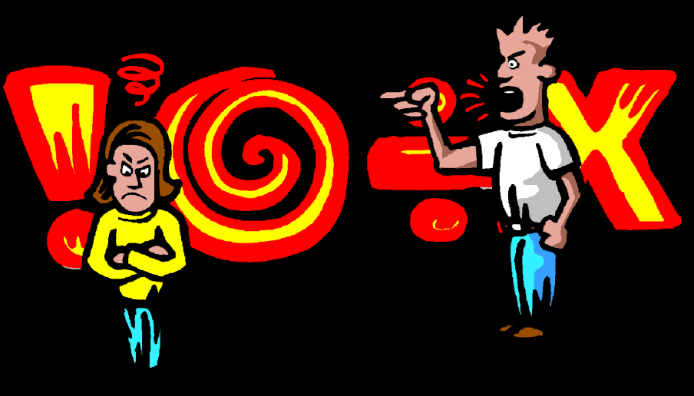
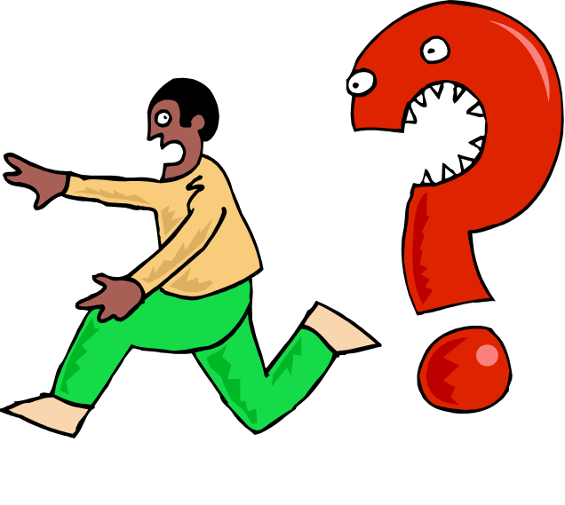
Remember they are people
They are coming from a place of emotion
  Generally fear
  Because they are emotional, they are illogical
Notes:
How to think about people challenging intellectual freedom
Remember they are people
They’re not necessarily bullies who want their own way
Mostly they’re not trying to be mean
They are coming from a place of emotion
Generally fear
The world can be a scary place
We all have things we don’t understand or appreciate
Everybody feels threatened sometimes
Because they are emotional, they are illogical
Appealing to logic or reason won’t work
I hate to use the term irrational, but one of the definitions of that term is “not logical or reasonable”
Meeting them with defensiveness won’t work
It only solidifies their determination to protect their position

Slide 16
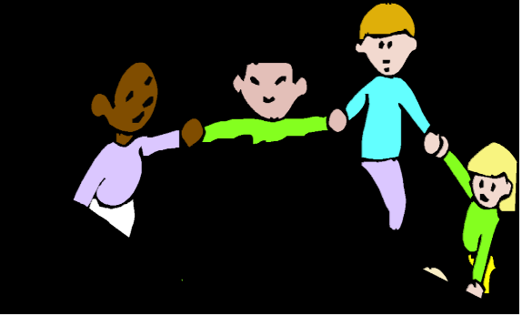

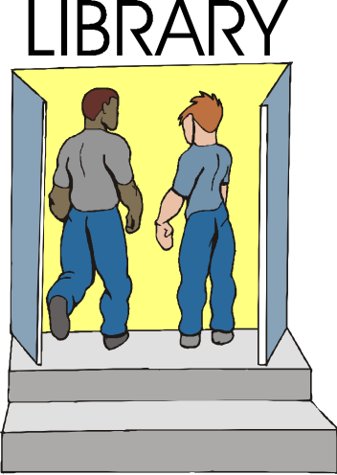


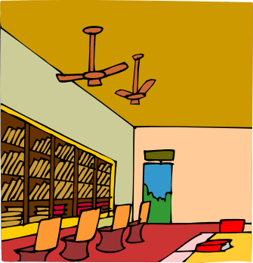
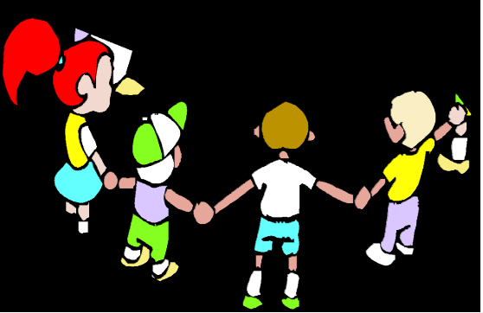
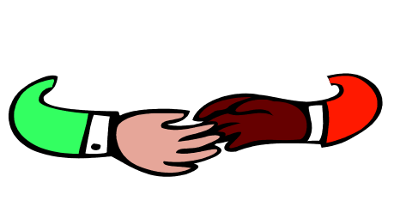
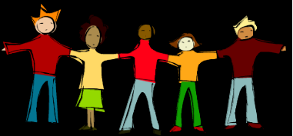
They frequently care about libraries a lot
LIBRARY
Notes:
They frequently care about libraries a lot
They can and do love libraries
In their minds, they’re just trying to make the library better
They see what they’re asking as minor
In fairness, they can’t imagine that anyone would disagree with them
If for no other reason, again, that they’re people
It’s not “wrong” to ask questions
Every library user has that right

Slide 17
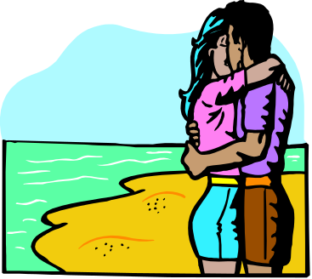


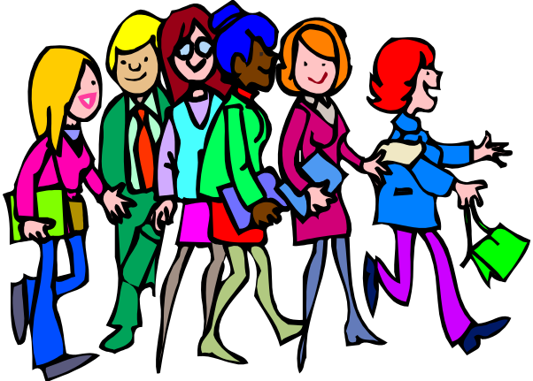
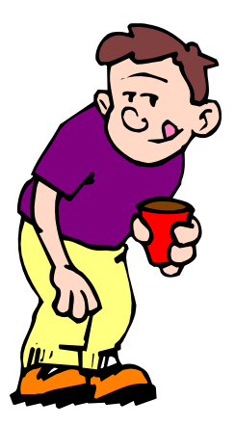

They deserve to be taken seriously
It can be hard to see them as realistic
* ! ! @ $ # & !
Notes:
It can be hard to see them as realistic
Seriously, your 14 year old doesn’t think about sex?
Your child needs to use the library to see porn?
Your public schooled child has never heard bad words?
You really believe someone is going to be damned for eternity because they walked past a shelf of books?

Slide 18
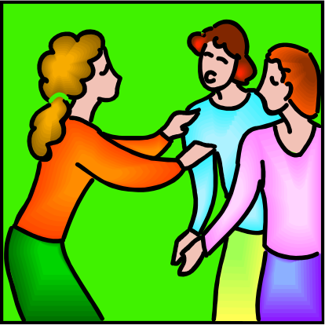


When someone expresses concerns to you as a Friend
Know your role
  Help them feel heard
  Share information
  Let them know what actions they can take
  Know what you can’t do
Notes:
Know your role
Help them feel heard
Share information
Let them know what actions they can take
Know what you can’t do
You don’t have to do any of these things if you don’t want to
You can just direct them to the library
That can be problematic though
People don’t like to feel as if they’re being brushed off
So this is what you can do

Slide 19


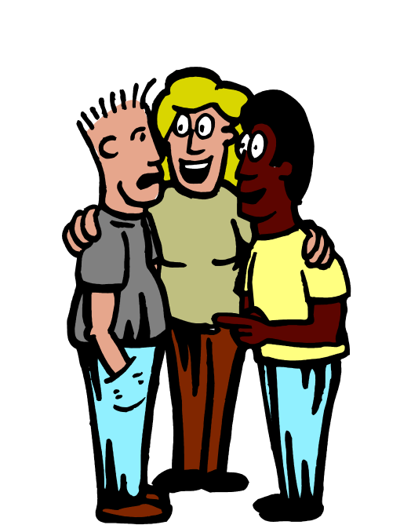

Everyone deserves to be taken seriously
Welcome their concerns
Notes:
I know I’ve said this before, but they deserve to be taken seriously
Even though they’re wrong
Especially because they’re wrong
Welcome their concerns
Thank them for using the library or at least being interested in it
Seriously, there are people in your community who don’t even know there is a library in it
Libraries are in more danger from people who don’t care about what we do than from ones who use our services

Slide 20
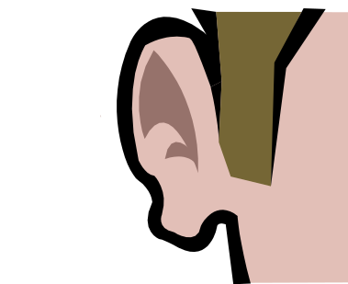

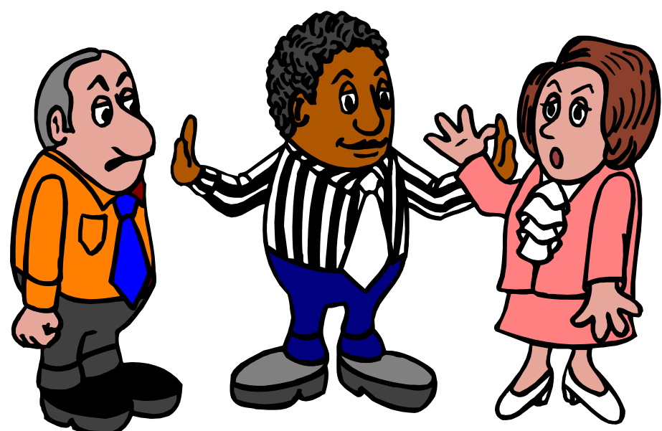
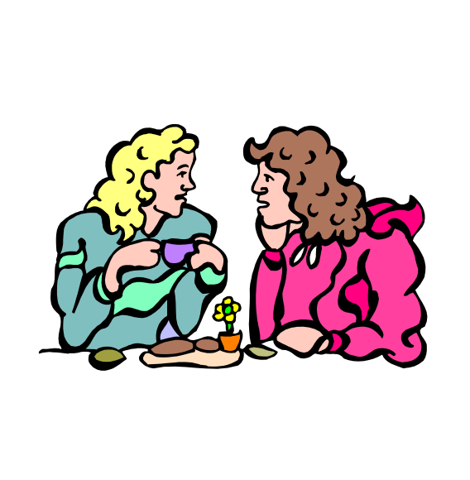
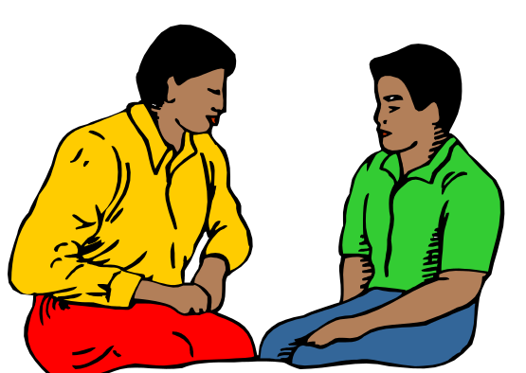
Be respectful
Acknowledge their feelings
Notes:
Be respectful
Make eye contact
Listen carefully
Don’t try to brush them off
Express that you know this is important to them
You don’t have to agree with someone to be respectful
Even if their concerns seem silly, that doesn’t make them less real
Try to find common ground in that the world can be difficult for anyone to navigate
It can be as simple as being polite
Don’t take their concerns personally
Acknowledge their feelings
Tell them you get that they’re frustrated
You understand that they want to protect someone

Slide 21



Accidents happen
Notes:
Remember that they might have a point
Probably not a good idea to tell them pornography is not actually illegal
Obscenity, which is a different thing, is
For the record, your public library does not knowingly own materials that meet the state’s legal definition of obscenity
We don’t need that headache
It’s possible that the library unknowingly owns materials that are borderline
Accidents happen
Libraries rely on reviews in selecting materials
The reviews don’t always tell us everything we need to know
A material may be more graphic than the review led a librarian to believe
Content might be geared toward older users

Slide 22
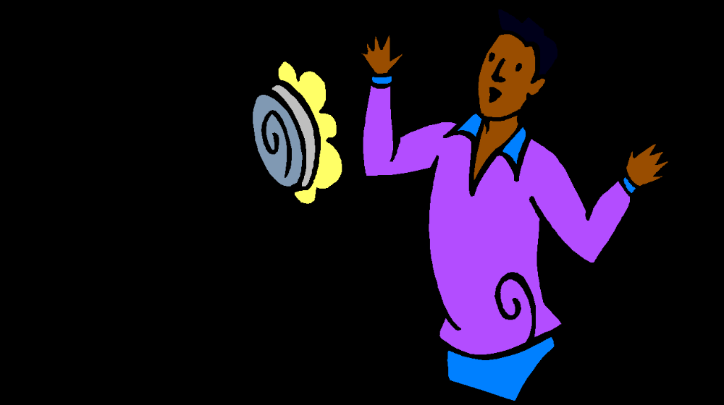



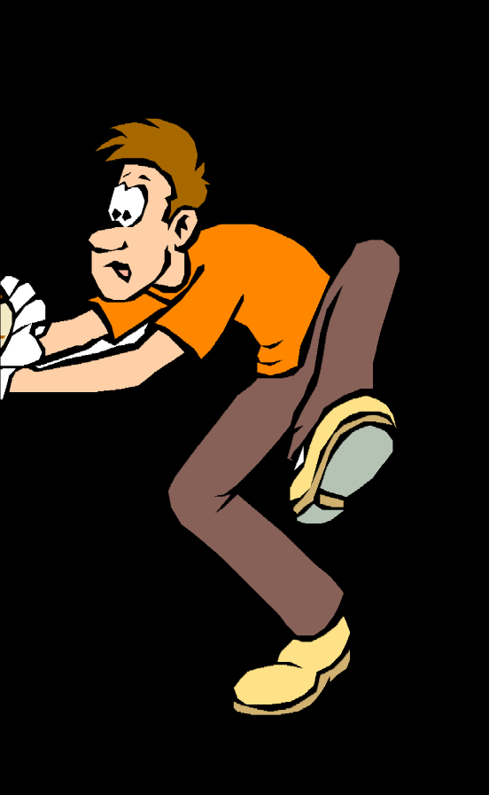
Surprises happen
Notes:
So sometimes there might be something on a shelf that really isn’t appropriate
It might be shelved for the wrong age group
It might have illustrations nobody knew about
It’s an unfortunate surprise
It’s not a common occurrence
In my whole career, I could probably count on my fingers the number of times it happened
Once the library is aware, they will deal with it and take appropriate action
The best thing you as a Friend can do is encourage the user to follow the reconsideration process

Slide 23



Share information
Universal library facts
  Libraries respect everyone’s right to consume whatever material they choose
  Libraries respect every parent’s right to guide their own children’s choices of material to consume
Notes:
There are certain universal library facts that you can share
Libraries respect everyone’s right to consume whatever material they choose
Or not to consume it
We don’t judge anyone’s choices in that regard
Libraries respect every parent’s right to guide their own children’s choices of material to consume
With young children, we expect parents to visit the library with their children and help them make choices in line with the parent’s values
With older children, we expect parents to have communicated their values to their children to help guide their choices
Reassure them that the values that they teach their children have an impact
If they’ve done a good job at that, what a child is exposed to will matter less

Slide 24

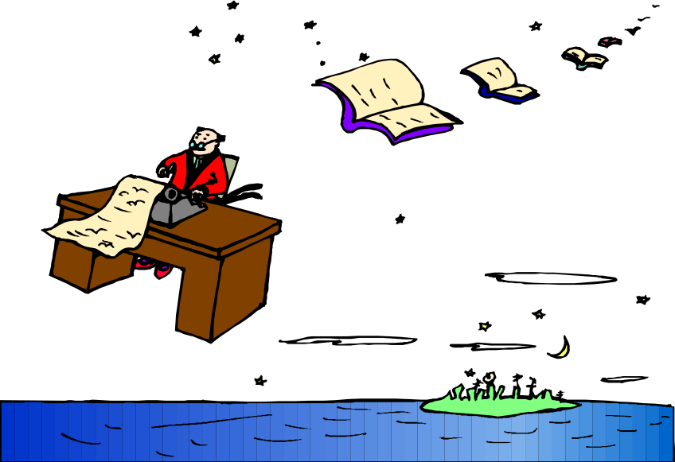

Share information
Universal library facts
  Libraries are expected to represent the entire community
  Libraries have policies to help determine what materials the library offers to its users
Notes:
Libraries are expected to represent the entire community
Everyone’s tax dollars support the library
Not everyone in the community has the same values
There are undoubtedly materials in the library that represent the individual’s values
Libraries have policies to help determine what materials the library offers to its users
As a Friend, it’s a good idea to make sure this is true
The policies should be publicly accessible
In many if not most cases, the policy is on the library’s website
Know how to navigate to it
Be able to explain that
If it’s not online, explain how to access it
Encourage your library administration to make it available online
This is also part of letting them know what actions they can take

Slide 25


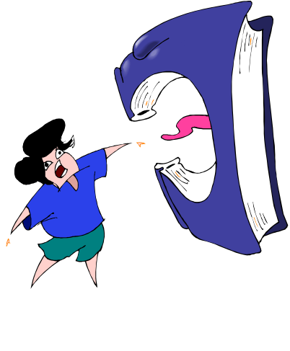

Asking for information
Try to find out specifically what the individual objects to and why
  What about the [material/issue] concerns them
Notes:
This one is kind of tricky
You really don’t want to get into an argument
Or a huge back and forth
You don’t have to
It’s perfectly fine to just encourage them to follow established processes
It can be useful to know where they’re coming from
Try to find out specifically what the individual objects to and why
This is information you can share with library administration
It can give them context to prepare a response
What about the material concerns you?
If it’s about the content, how did you find out about it?
Did you observe the content? All of it?

Slide 26


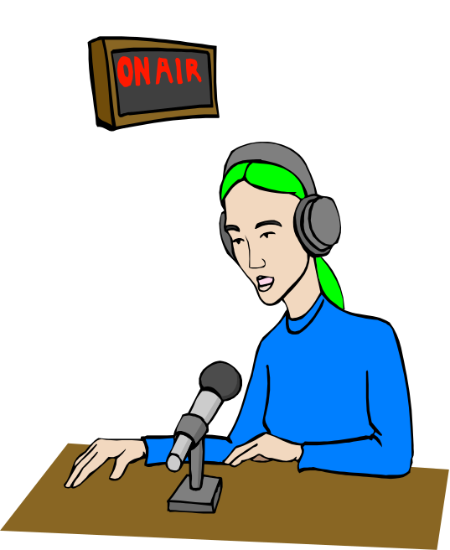
Asking for information
Try to find out where they learned about the issue
Notes:
It can help to know where the individual learned about this issue
This is information you can share with library administration
It can give them context to prepare a response
If it relates to something that’s recently been on talk radio, or appearing in online sources, it’s helpful to know that it’s out there

Slide 27

Editorial Comment
SOAP BOX
Notes:
My unpopular opinion on the soapbox
As librarians, we’re taught that when someone questions a material, to ask if they have consumed the entire thing
Read the whole book, watched the whole video, etc.
It might make a difference for them to have context for whatever they’re objecting to
In my recent experience, it’s pretty pointless to ask this
They usually haven’t consumed the whole thing and have no intention of doing so
Whatever media they are relying on has told them all they want to know
It doesn’t hurt to ask, but I don’t think it does any good
You can gently suggest that they review the entire content, but don’t be surprised if they refuse

Slide 28


DON’T
  Repeat negatives
Notes:
Don’t repeat negatives
All the other person hears is the negative
“The library doesn’t have pornography”—all they hear is library pornography
Just like saying “Vaccines don’t cause autism”
Use positive phrasing instead
Something like “The library has a lot of materials that meet your needs”
“The library staff will be happy to help you find something that you want”

Slide 29
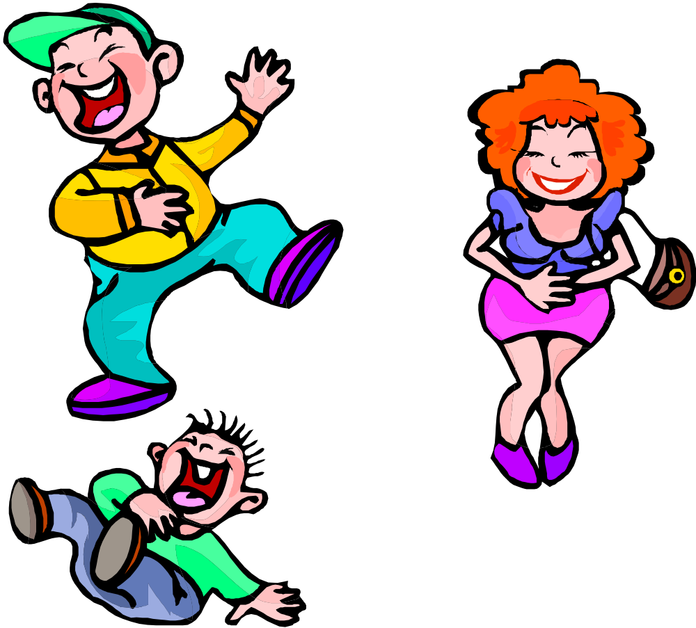

DON’T
  Belittle or make light of their concerns
Notes:
Don’t belittle or make light of their concerns
It’s kind of hard sometimes
You know their child has heard cursing, especially if they go to public school
Even though they should know that, they don’t
Affirm their right to their own values and to teach those values to their children
Suggest that library staff can help find materials they feel are appropriate

Slide 30


DON’T
  Minimize their concerns
Notes:
Don’t minimize their concerns
Yes, very often what they think will happen is unlikely
It’s real to them
The library is not doing them a favor by listening
They are doing the library a favor by using its services and caring enough to raise concerns

Slide 31


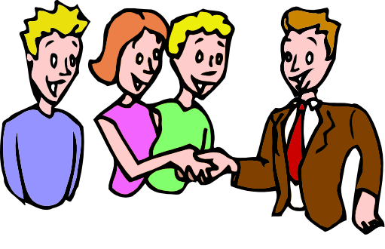
What can the concerned person do?
Submit a reconsideration request
  Explain as much as you can how the process works
  Reiterate that it will be taken seriously
Become a Friends member
Notes:
Of course, they can submit a reconsideration request
Know how the process works in your library
It usually begins with a reconsideration form
Know where to get the form
Know what to do with it when completed
Know if the library has a timeline for responses
All this is information that you can and should share
Reiterate that it will be taken seriously
Becoming a Friends member might seem counterintuitive
It might expose them to see how seriously the library takes its role
Maybe even open their eyes to some different ideas

Slide 32




Know what you can’t do
Change their minds
Solve their issue
Notes:
Change their minds
First of all, you can’t
You’re talking to the hand, so to speak, or to someone who’s covering their ears
It goes back to the fact that this is an emotional issue, not a logical one
The more you try to push logic, the more they will push back
It won’t help defuse the situation
The bottom line is they want something DONE
Learn about how to respond to irrational people
Solve their issue
Remind them that you are a community member just like them
You can’t force the library to take an action
As a Friend, you don’t control library policy
Encourage them to take their concerns to library administration
Again, let them know that the library wants to hear from them

Slide 33
Know what you can’t do
Speak for the library
Carry their concerns to the library
Notes:
Speak for the library
Don’t make promises you can’t keep
You can promise that every concern will be taken seriously
Not that anything specific will happen
Carry their concerns to the library
Only they can share their concerns accurately
It’s okay to tell them that you want to avoid confusion
Communication morphs the more people it goes through
To keep things clear, they should communicate directly

Slide 34

Support your library through challenges
Educate yourself
Know how your library enriches the community
Show your support
Notes:
Educate yourself
Know what intellectual freedom is
Be able to share that knowledge
Be aware of current events and challenges to libraries
FOLIO and OLA are good resources
Have positive examples of how the library helps the community
Early literacy initiatives
Donations to local charities
If your library is facing challenges
Write letters to the editor
Attend Board meetings
Be vocal about your support

Slide 35
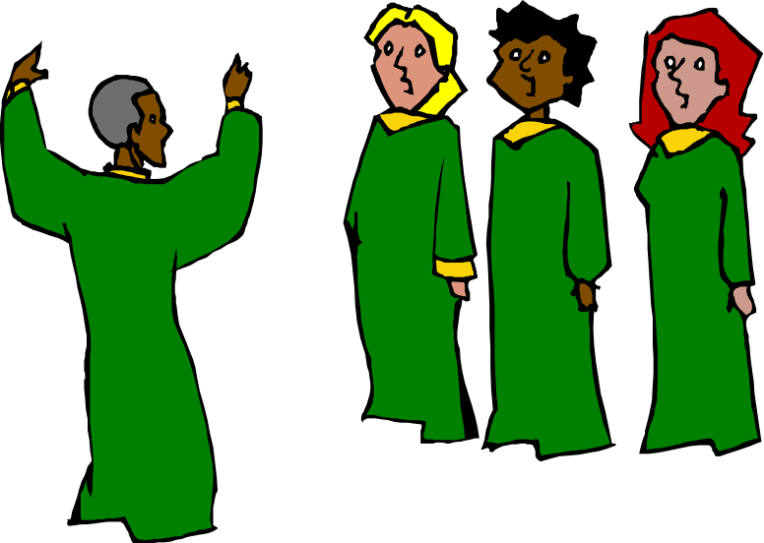


Support your library through challenges
Join your library’s Friends group
Join FOLIO
Notes:
This is where I’m preaching to the choir, but belong to your local Friends group
Keep up your membership
Volunteer for events
Join FOLIO
It’s cheap
You already know we support local Friends groups
You can get information about what’s going on in the library world
Maybe even become a Board member!

Slide 36



Libraries and intellectual freedom are for all of us

Slide 37
A Few Useful Resources
challenges_to_materials_and_programs_the_role_of_friends_of_the_library.pdf
Seven Ways to Respond to Claims that are made to Justify Book Bans - counter-force
Maryland Today | 5 Tips for Responding to Book Challenges
How to Deal With Irrational People - The Overwhelmed Brain
Managing Conversations with Irrational People - Relationships - eNotAlone
Intellectual Freedom Tools - Oklahoma Library Association
Intellectual Freedom Resources for Trustees, Friends, & Foundations | United for Libraries

Slide 38


Questions??

Slide 39
Pauline Rodriguez-Atkins
pb_r@yahoo.com

